Slide 1
HARSHITHA R
2021PITAI117
AIDS A
NAAN MUDHALANVAN PROJECT
3/21/2024 Annual Review

Slide 2
PERSONALITY PREDICTION THROUGH CV
3/21/2024 Annual Review

Slide 3

PROBLEM STATEMENT
Personality of a person plays a crucial role in the organizational progress and also in the self-development process in an individual's life. One of the typical ways to predict the person's personality is either by a standard review or by scrutinizing the Curriculum Vitae of the candidate. The Conventional method of recruiting the candidates involves manual short listing of job seekers resumes according to the requirement of the company. In this work, a system that automates the task of segregating candidates based on eligibility criteria and personality evaluation in a recruitment process is proposed. To meet this requirement an online application is developed for the registration of candidate's details and analysis of candidate's personalities through an online Multiple-Choice Question (MCQ) test containing personality quizzes. Then the system analyzes professional eligibility by comparing the uploaded Curriculum Vitae trained datasets. This system employs a machine learning algorithm namely “Logistic Regression” which helps to choose fair decisions to recruit a suitable candidate. Thus, the final results of the personality quizzes will be sent to both candidates and the admin.

Slide 4

PROJECT OVERVIEW
This method can be applied to a wide range of corporate functions that might call for qualified candidates. The hiring, training, and firing department's workload will be lessened by this approach, as will the workload of other employees. An expert will be provided for the organization by this system, which will assist in choosing the best applicant for the intended job profile. Based on their personality scores, the admin may quickly screen candidates and choose the best fit for a given job profile. The practice of using Natural Language Processing (NLP) can be characterized as a means of reducing the gap between humans and machines by making a machine more human-like.
3/21/2024 Annual Review

Slide 5

WHO ARE THE END USERS?
This model was created mainly for the higher official recruiters who find it really difficult to scan every other resume or CV that comes by
The main consumers of this model are the corporations who are involved in the recruitment business
The system built in this project predicts personality of peoples by using their gender, age, score of openness, conscientiousness, extraversion, agreeableness, neuroticism and experience. It parses all the data from CV/resume and on the result page, it shows all the information from the entered data and uploaded resume.
3/21/2024 Annual Review

Slide 6
BACKGROUND OF PERSONALITY PERCEPTION
The Big Five Personality Traits Model measures five key dimensions of people's personalities:
Openness: sometimes called "Intellect" or "Imagination," this measures your level of creativity, and your
desire for knowledge and new experiences.
Conscientiousness: this looks at the level of care that you take in your life and work. If you score highly in
conscientiousness, you'll likely be organized and thorough, and know how to make plans and follow them
through. If you score low, you'll likely be lax and disorganized.
Extraversion/Introversion: this dimension measures your level of sociability. Are you outgoing or quiet,
for instance? Do you draw energy from a crowd, or do you find it difficult to work and communicate with
other people?
Agreeableness: this dimension measures how well you get on with other people. Are you considerate,
helpful and willing to compromise? Or do you tend to put your needs before others'?
Natural Reactions: sometimes called "Emotional Stability" or "Neuroticism," this measure emotional
reactions. Do you react negatively or calmly to bad news? Do you worry obsessively about small details, or
are you relaxed in stressful situations?

Slide 7

YOUR SOLUTION AND ITS VALUE PROPOSITION
This system uses logistic regression for training the model and pyresparser module for parsing the information from resume which is built using nltk and spaCy module in python. Description of Methods and Flow in the System:
#train_model class
#main method
#predict_person method
#OpenFile method
#prediction_result method
#check_type method
3/21/2024 Annual Review

Slide 8
The system built in this project predicts personality of peoples by using their gender, age, score of openness, conscientiousness, extraversion, agreeableness, neuroticism and experience. It parses all the data from CV/resume and on the result page, it shows all the information from the entered data and uploaded resume. This system uses logistic regression for training the model and pyresparser module for parsing the information from resume which is built using nltk and spaCy module in python.
1. train_model class: It contains two method which train model and predict the result by giving the various values.
a. train method: It read the dataset for training the model from a csv file and build a model
using Logistic Regression. It uses different 7 values for training the model
b. test method: It predict the personality of a person by passing an array of values that contains gender, age and other 5 personality characteristics.
2. main method: We start with creating an object of train_model class and train the model by calling train method of class. Then we initialize a variable with Tk object and design the landing page of system using labels and button. A button with name Predict Personality is designed which calls
predict_person method.
3. predict_person method: We withdraw the root tkinter window and create a new toplevel window and configure its size and attributes. We label the heading of window followed by various labels and
their entries. For selecting of a resume file, user needs to press choose file button which then calls Openfile method that takes an argument of button. In predict_person method, various entries are
taken for predicting the personality. Submit button pass all the values to prediction_result.

Slide 9
4. OpenFile method: It tries to open the directory with default address name and file types and except if file not chosen. After try except block, the method changes the name of choose file button in
predict_person method with the base name of file so that user can know about the chosen file.
5. prediction_result method: This method firstly closes the previous tkinter window which was used to take the data from user. After this, it calls test method of model object and stores the result returned by method. After this it parse all the information from resume and stores in a variable followed by a try except block which try to delete name and validate mobile number from fetched information from resume. Then it prints all the data submitted by user on console. After this, the method popup a full screen window which shows all the parsed information and predicted personality on GUI window along with the definition of each personality characteristic’s definition.
6. check_type method: It converts various strings and numbers into desired format and converts lists and tuples in string

Slide 10

THE WOW IN YOUR SOLUTION
#Interactive and easy to use.
#Extract all the important features of resume in seconds
#Easily predict the personality of applicants
#It can be extended for commercial uses
#It can be made more interactives where we can easily handle bulk data and represent it.
#It can improve the training model for various addition features that help us to predict more accurate
result.
#Instead of direct asking the five characteristic values we can add questionaries’ which ask some
multiple-choice questions and auto calculate the various values
3/21/2024 Annual Review
10

Slide 11
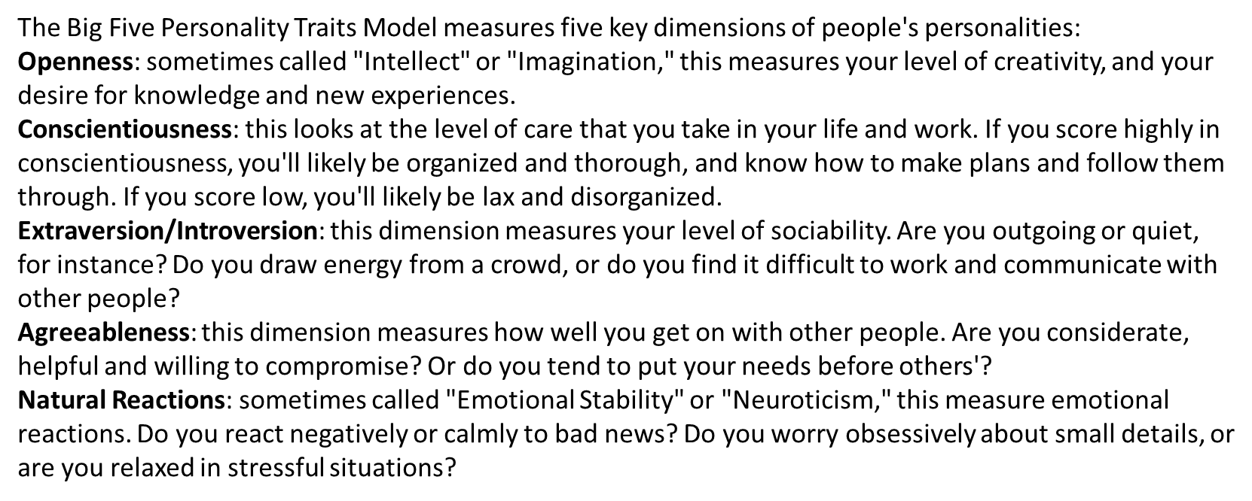
MODELLING
11

Slide 12
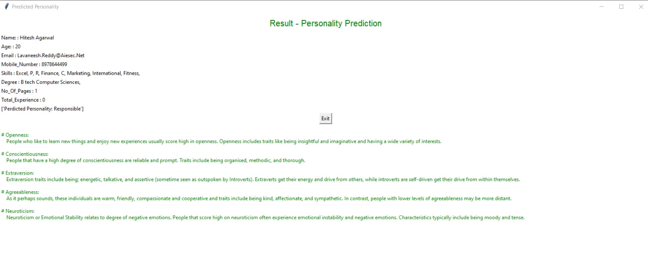
RESULTS
PREDICTED PERSONALITY ON VARIOUS TEST CASES
Thus we were are able to come to a rough decision about a person’s personality based upon analysing their curriculam vitae
12

